Slide 1
Northfield IB Computer Science
Jason Morales | LinkedIn – Principal Customer Success Account Manager
Jason Cook | LinkedIn – Principal Global Black Belt Software Solution Engineering, Cloud & AI Platforms

Slide 2



Agenda
Intros
Our personal career journeys
What is it like to work at Microsoft?
How is AI changing professions in the tech industry?
What career paths are there in tech?
What choices should you make now in terms of habits, topics of study, extracurriculars, etc?
Q/A

Slide 3
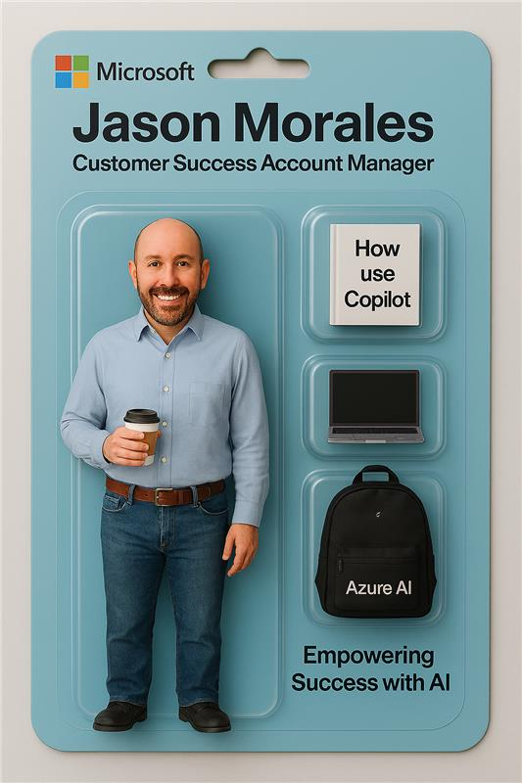

Bachelor’s Degree in Information Technology
Principal Customer Success Account Manager at Microsoft
Focus Areas
Driving customer success and adoption of Microsoft cloud solutions
Partnering with enterprise customers on AI transformation and Copilot programs
Championing mentorship and inclusions networks.

Slide 4
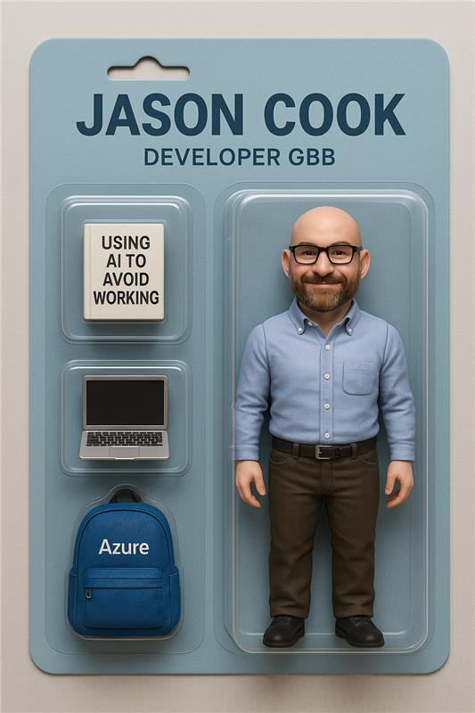
Bachelor’s Degree in Mathematics
Software Engineering – Enterprise Java
R&D - Cloud Native Architecture / Prototyping
Focus Areas
AI / Developer tools / Platform Engineering
Leadership / Consulting - Cloud Native Architecture and Processes

Slide 5
